Slide 1
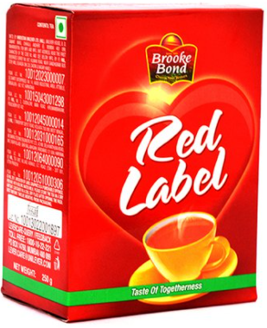

Polymorphism
Object Oriented Programming
Polymorphism best explained:
1) Mom: Son go and get Red Label Son: 1 or 2 kilo??
2) Dad : Son go and get Red Label Son: Quarter or Half…??

Slide 2
Polymorphism
Object-Oriented Programming

Slide 3
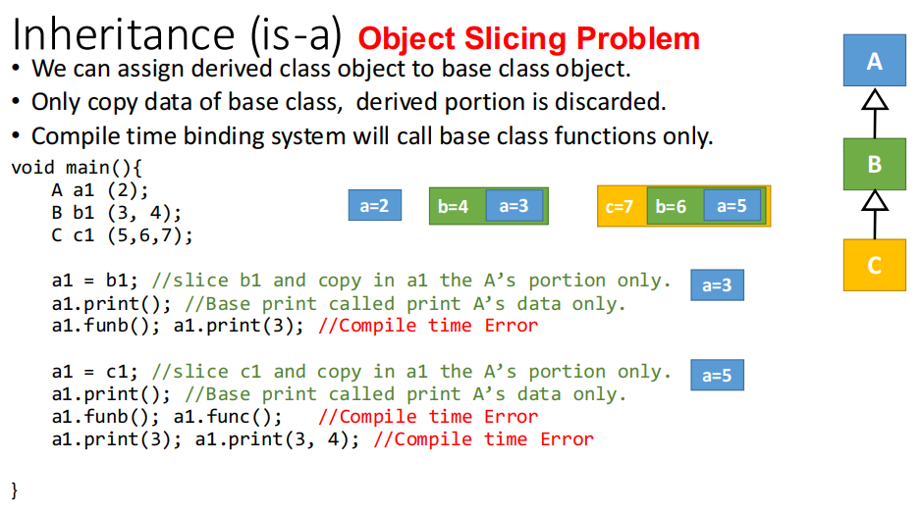
Compile Time Binding or Static Binding
One of the key features of class inheritance is that a pointer to a derived class is type-compatible with a pointer to its base class. Polymorphism is the art of taking advantage of this simple but powerful and versatile feature.

Slide 4
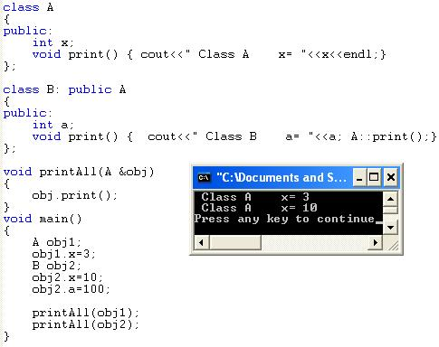
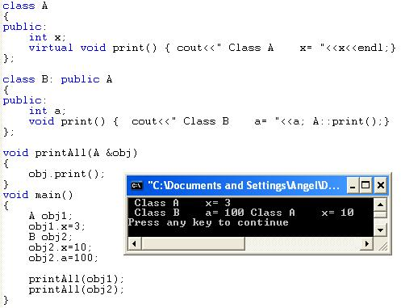

Slide 5
The word “polymorphism” means that the one and same class may show many (“poly”) forms (“morphs”) not defined by the class itself, but by its subclasses.
Another definition says that polymorphism is the ability to realize class behavior in multiple ways.
To understand the true nature of the phenomena, I believe that an example will work better.

Slide 6
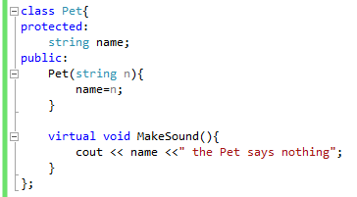
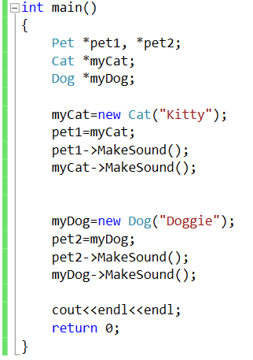
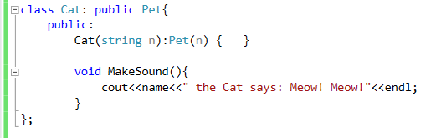
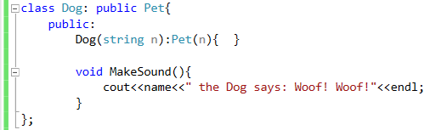
Output:
Kitty the Cat says: Meow! Meow!
Kitty the Cat says: Meow! Meow!
Doggie the Dog says: Woof! Woof!
Doggie the Dog says: Woof! Woof!

Slide 7
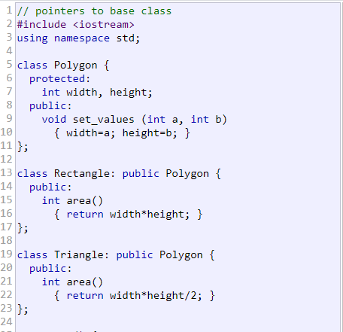
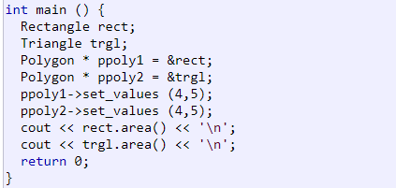
Output:
20
10
So what we need?
We need some kind of MAGIC, through which area() of Rectangle or Triangle can be called having just pointers of the base class.
Member area could have been accessed with the pointers to Polygon if area were a member of Polygon
instead of a member of its derived classes. But the problem is that Rectangle and Triangle implement different
versions of area, therefore there is not a single common version that could be implemented in the base class.
Ref: http://www.cplusplus.com/doc/tutorial/polymorphism/

Slide 8
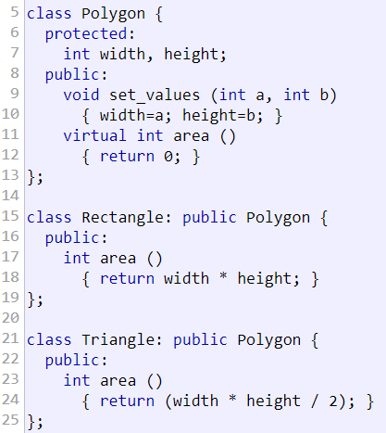
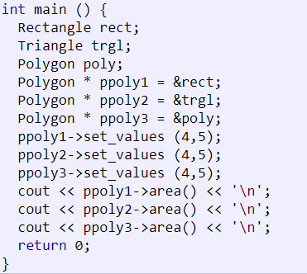
Output:
20
10
0
What will happen if we remove virtual keyword in Polygon class?
Do you remember slicing problem?
A class that declares or inherits a virtual function is called a polymorphic class.
Notes:
To build a bridge over the sea, this slide says all about POLYMORPHISM.

Slide 9
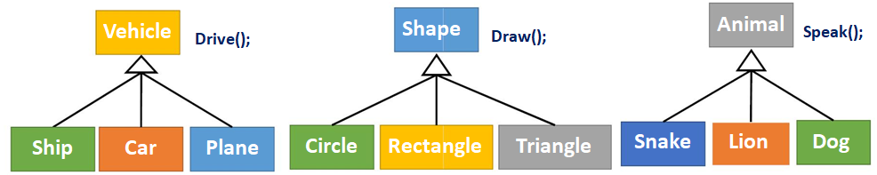
Polymorphism is a feature of OOP that allows the object to behave differently in different conditions.
Polymorphism
• Poly means “Many” Morphism mean “Forms/Shapes”
• Same base type behavior will be changed according to object of derived.
• Use objects without knowing their types explicitly.
• Extend the program with more functionalities through derive classes.
• Need one single array of base class to collect all different objects of derived.
• Base class represent a larger set for all objects (base and derived)
Vehicle
Shape
Animal
Ship
Car
Plane
Circle Rectangle Triangle
Snake Lion Dog

Slide 10
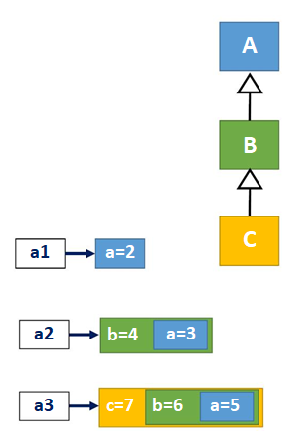
Polymorphism
A
B
C
• One object can show different behaviors.
void main(){
A * a1 = new A(2); //A’s pointer to A’s object
a1->print(); //A’s print called.
a1
a=2
b=4
A2
a=3
A * a2 = new B(3, 4); //A’s pointer to B’s object
a2->print(); //Should call B’s print
c=7 b=6 a=5
A * a3 = new C(5, 6, 7); //A’s pointer to C’s object
a3->print(); //Should call C’s print
}

Slide 11

Polymorphism
1. Only base class inherited functions can be called through base pointer.
A
B
C
2. Override base class function in derived classes.
3. Change Compile time binding of functions to Run time binding,
1. Run time binding: Call functions according to object type not pointer type.
2. Make functions virtual in base class.
• Inherited as virtual in all derived classes, no need to make virtual again.
• All virtual functions binding change to runtime.
class A{
int a;
public:
A(int a=0){ this->a=a;}
virtual void print(){ cout<<a;}
};

Slide 12
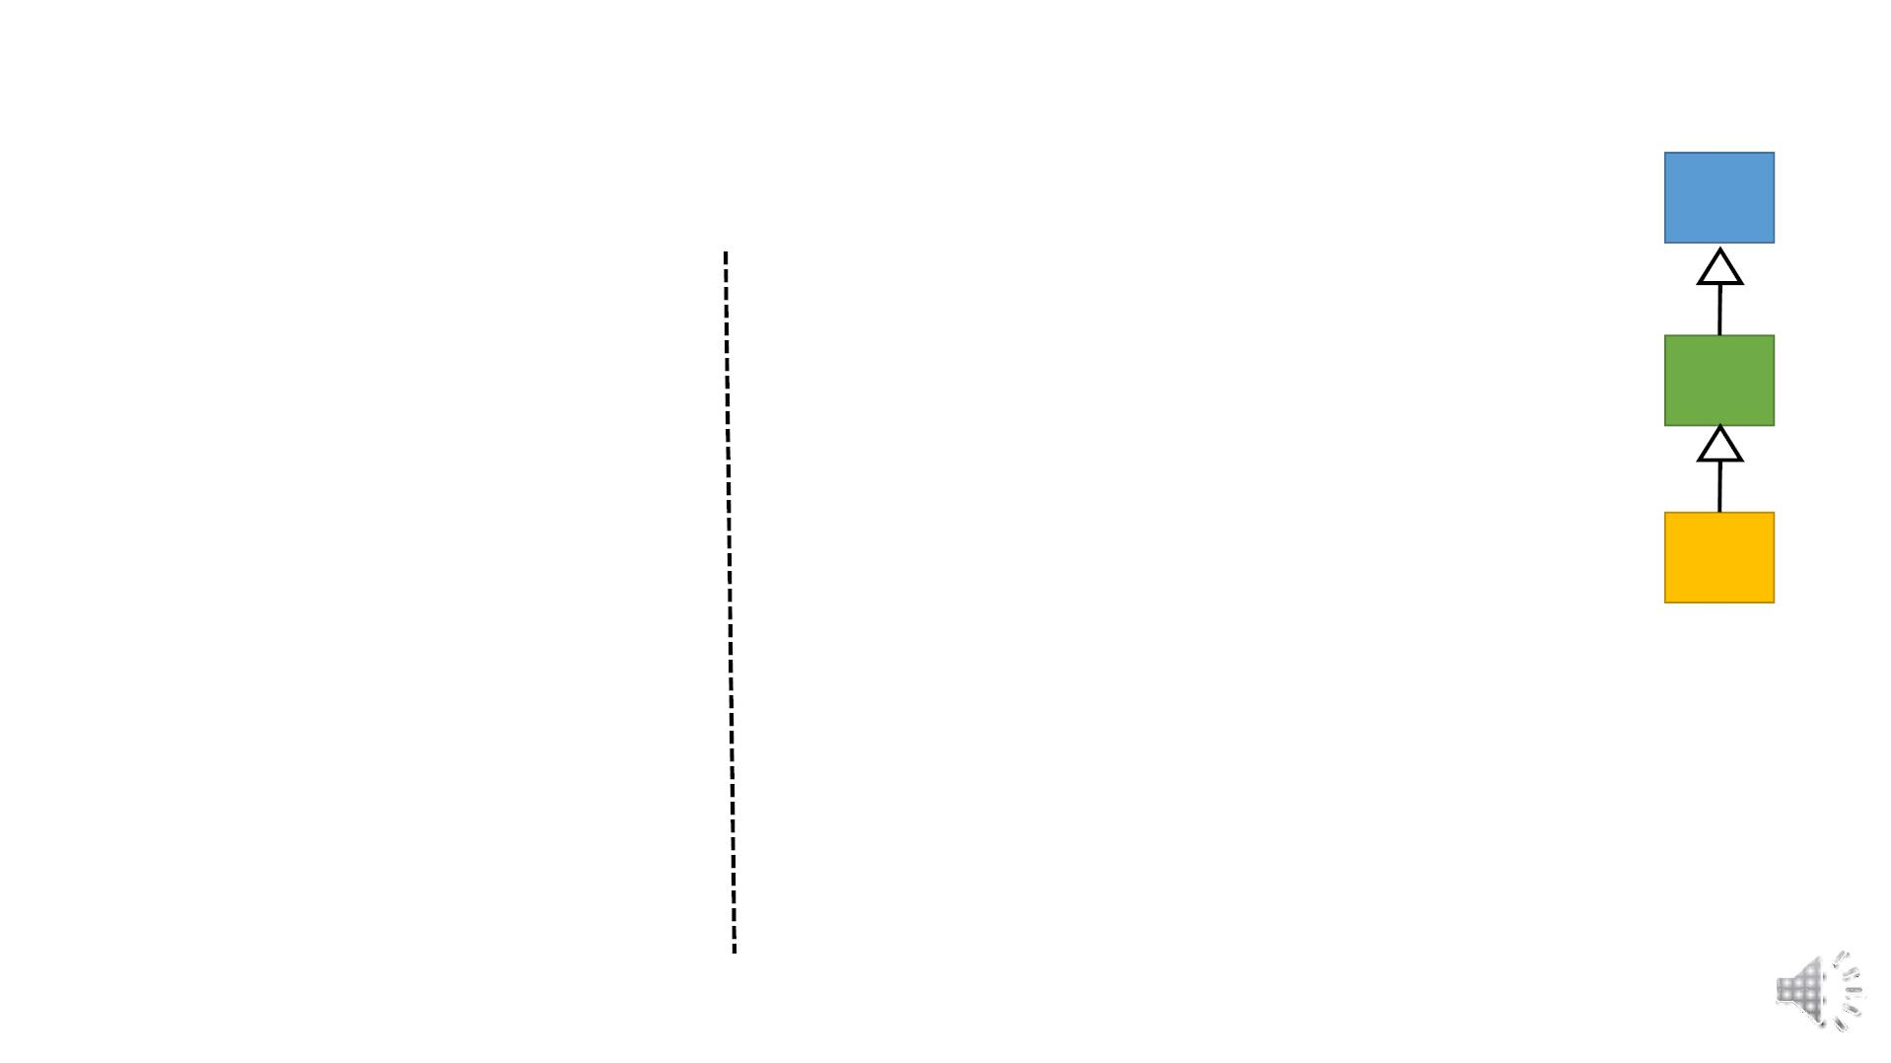
Runtime Binding
A
B
C
class A{
int a;
public:
class B: public A{
int b;
public:
A(int a=0){ this->a=a;}
B(int a=0, int b=0):A(a)
{ this->b = b;}
virtual void print(){ cout<<a;}
};
//override print function inherited from A
virtual void print(){
A::print();
cout<<b;
}
//overload print function inherited from A
void print(int x){ cout<<x+b; }
void funb() { cout<<“funb”<<endl};
};

Slide 13
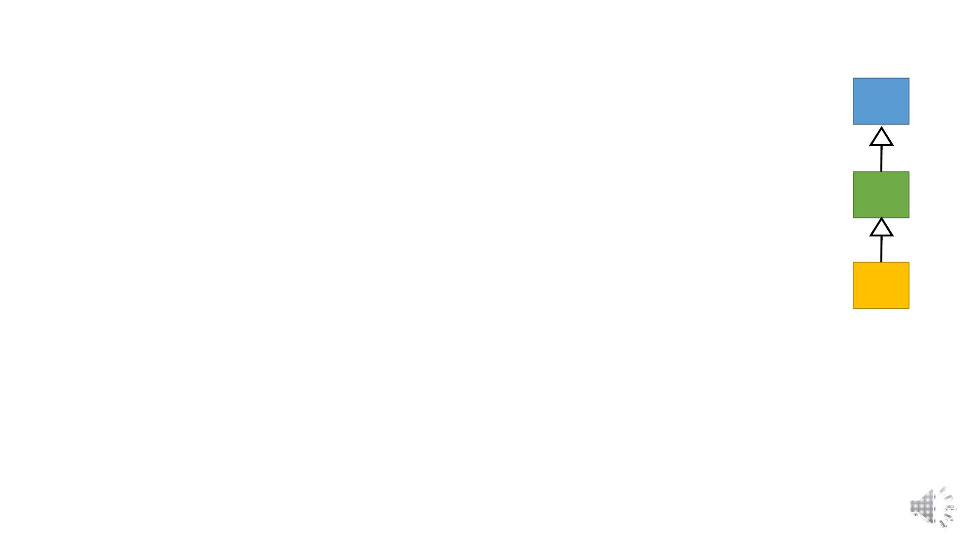
Runtime Binding…
A
B
C
class C: public B{
int c;
public:
C(int a=0, int b=0, int c=0) :B(a,b)
{ this->c = c;}
//override print function inherited from B
virtual void print() {
B::print();
cout<<c;
}
//overload print function inherited from B
void print(int x, int y){
cout<<x+y+c;
}
void func(){ cout<< “func” <<endl; }
};

Slide 14
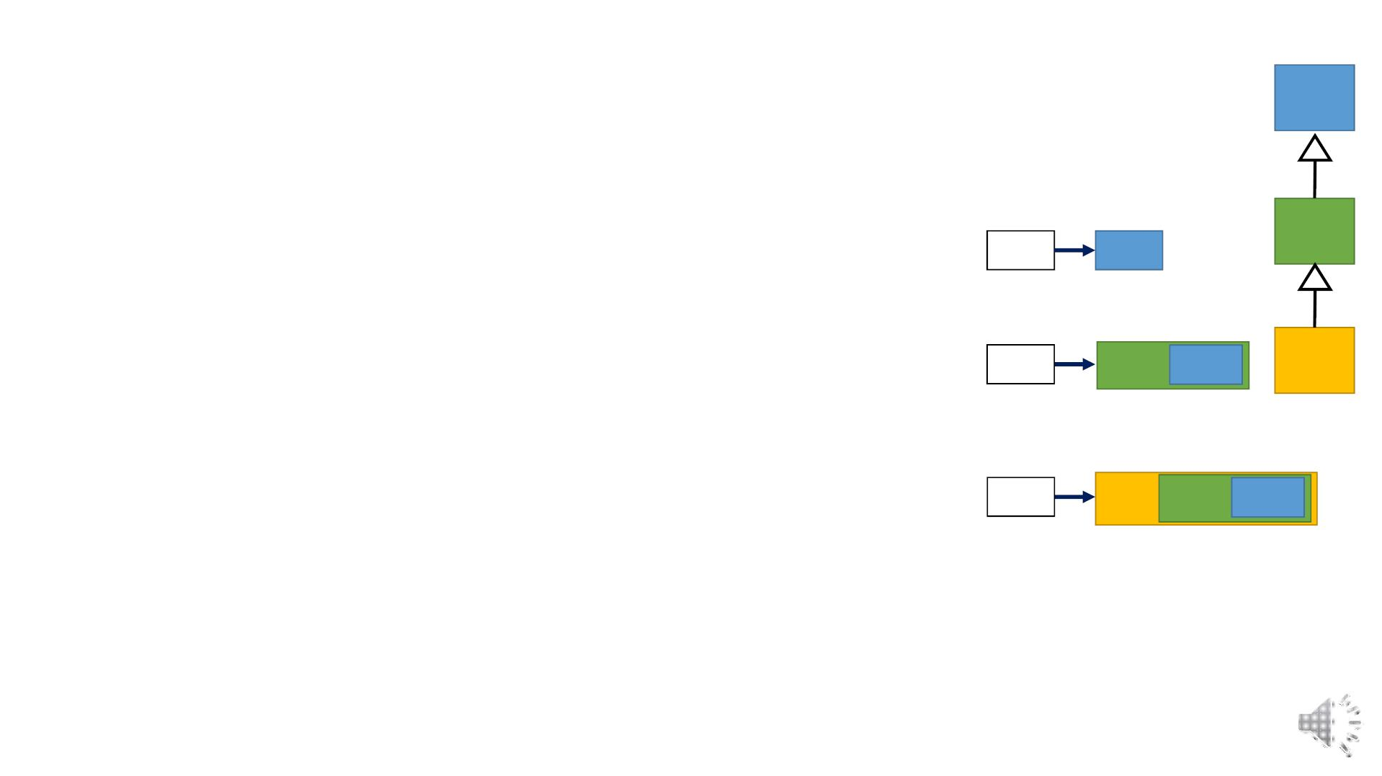
Runtime Binding…
A
B
C
• Call the function according to the type of object not pointer.
void main(){
A * a1 = new A(2); //A’s pointer to A’s object
a1->print(); //A’s print called.
a1
a=2
A * a2 = new B(3, 4); //A’s pointer to B’s object
a2->print(); //B’s print called
a2
b=4
a=3
a2->funb(); a2->print(3); //Compile time Error
A * a3 = new C(5, 6, 7); //A’s pointer to C’s object a3
a3->print(); //C’s print called
c=7 b=6 a=5
a3->funb(); a3->print(3); //Compile time Error
a3->func(); a3->print(3,8); //Compile time Error
}

Slide 15
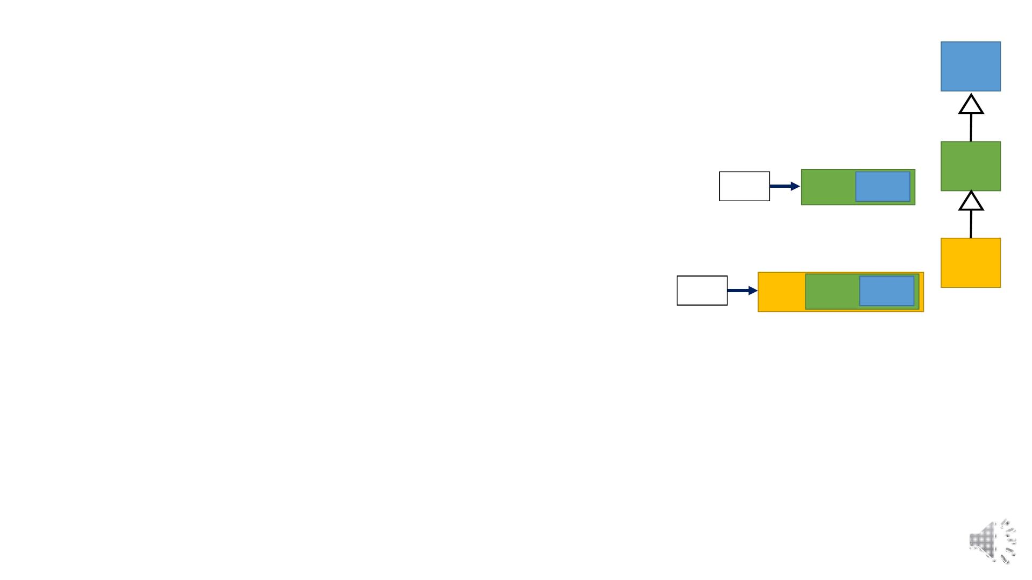
Runtime Binding…
A
B
C
• Call the function according to the type of object not pointer.
void main(){
B * b1 = new B(9, 10); //B’s pointer to B’s object
b1->print(); //B’s print called.
b1
b=10 a=9
B * b2 = new C(5, 60, 70); //B’s pointer to C’s object
b2->print(); //C’s print called.
b2->funb(); b2->print(3);
b2
c=70 b=60 a=5
b2->func(); b2->print(3,8); //Compile time Error
B * b3 = new A(2); //Error: B’s pointer to A’s object
//Every derived is a base but every base is not a derived.
//Allowed if explicit cast made
}

Slide 16
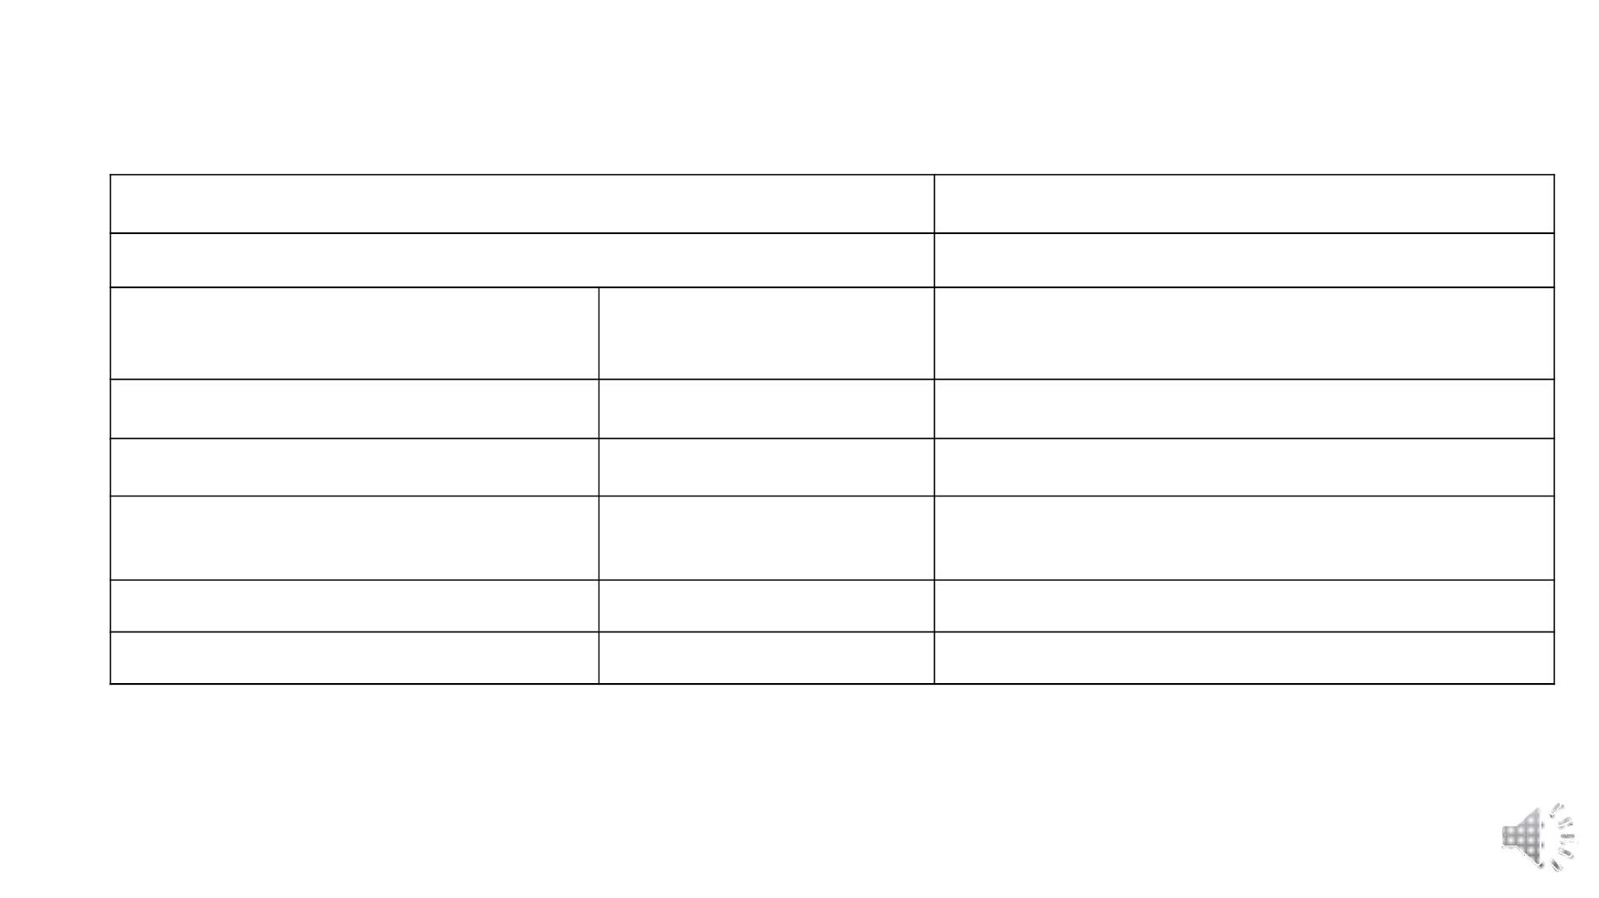
Runtime Binding…
Base class static object
Call base class functions only
Derived class static object
Call derived class functions & inherited functions.
Derived class static
object
Call base class functions only.
Slicing Issue only copies base data in base object
Base class static object
Derived class static object
Base class static object Error: Explicit cast required
Base class pointer or reference
Base class object
Call base class functions only
Call derived class overridden functions that exist
in base.
Base class pointer or reference
Derived class object
Derived class pointer or reference Base class object
Derived class pointer or reference Derived class object
Error: Explicit cast required
Call derived class functions & inherited functions.

Slide 17
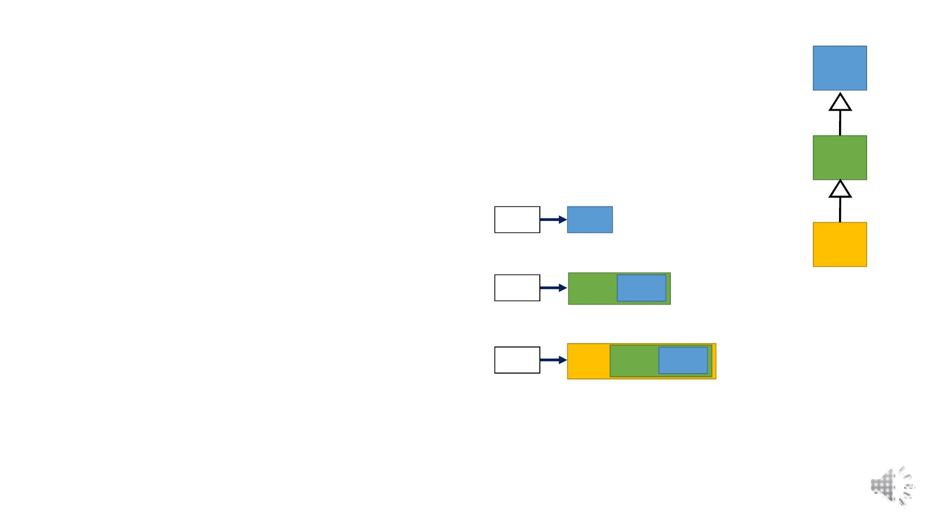
Inheritance (is-a) Virtual Destructor
• Destructor should be called according to object type.
A
B
C
• Derived class may have some dynamic members need to deallocate.
void main(){
A * a1 = new A(2); //A’s pointer to A’s object
a1->print(); //A’s print called.
a1
a=2
A * a2 = new B(3, 4); //A’s pointer to B’s object
a2->print(); //B’s print called
a2
b=4 a=3
A * a3 = new C(5, 6, 7); //A’s pointer to C’s object
a3->print(); //C’s print called
a3
c=7 b=6 a=5
delete a1; //A’s destructor called
delete a2; //A’s destructor called, should call b’s
delete a3; //A’s destructor called, should call c’s
}

Slide 18

Inheritance (is-a) Virtual Destructor
A
B
C
class A{
int a;
public:
class C: public B{
int c;
A(int a=0){ this->a=a;}
virtual void print(){ cout<<a;}
virtual ~A(){}
public:
C(int a=0, int b=0, int c=0) :B(a,b)
{ this->c = c;}
};
//override print function inherited from B
class B: public A{
int b;
void print(){
B::print();
cout<<c;
public:
B(int a=0, int b=0):A(a)
{ this->b = b;}
void print(){
A::print();
cout<<b;
}
virtual ~C(){}
};
}
• Make destructor virtual too.
virtual ~B(){}
• Destructor is not inherited so make it
};
virtual in all classes.

Slide 19
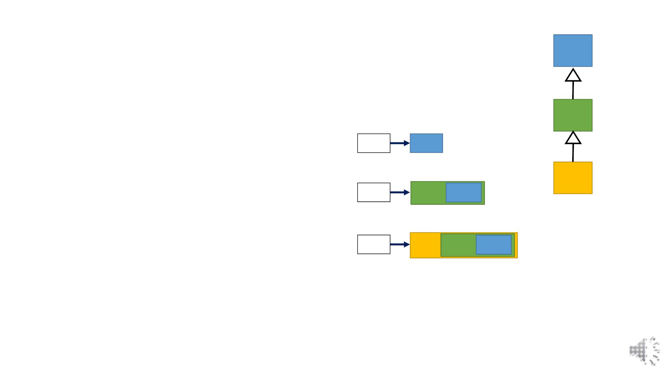
Inheritance (is-a) Virtual Destructor
• Destructor should be called according to object type.
A
B
C
void main(){
A * a1 = new A(2); //A’s pointer to A’s object
a1->print(); //A’s print called.
a1
a=2
A * a2 = new B(3, 4); //A’s pointer to B’s object
a2->print(); //B’s print called a=3
a2
b=4
A * a3 = new C(5, 6, 7); //A’s pointer to C’s object
a3->print(); //C’s print called
a3
c=7 b=6
a=5
delete a1; //A’s destructor called
delete a2; //B’s destructor called, which also calls A’s
delete a3; //C’s destructor called, which also calls B’s then A’s
}

Slide 20
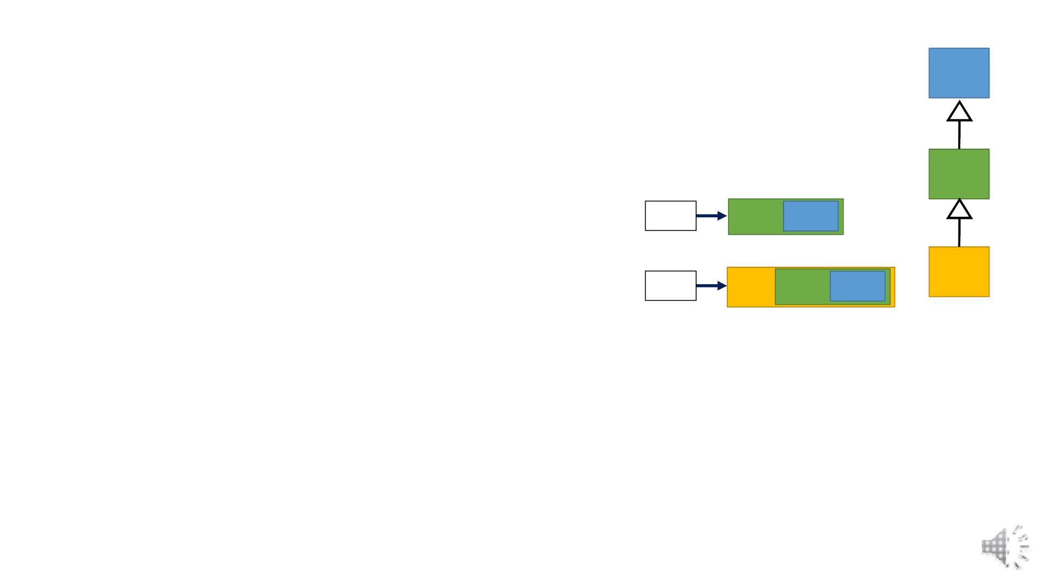
Inheritance (is-a) Virtual Destructor
• Call the function according to the type of object not pointer.
A
B
C
void main(){
B * b1 = new B(9, 10); //B’s pointer to B’s object
b1->print(); //B’s print called.
b1
b=10 a=9
B * b2 = new C(5, 60, 70); //B’s pointer to C’s object
b1->print(); //C’s print called.
b2
c=70 b=60 a=5
B * b3 = new A(2); //Error: B’s pointer to A’s object
//Every derived is a base but every base is not a derived.
//Allowed if explicit cast made
delete b1; //B’s destructor called, which also calls A’s
delete b2; //C’s destructor called, which also calls B’s then A’s
}

Slide 21
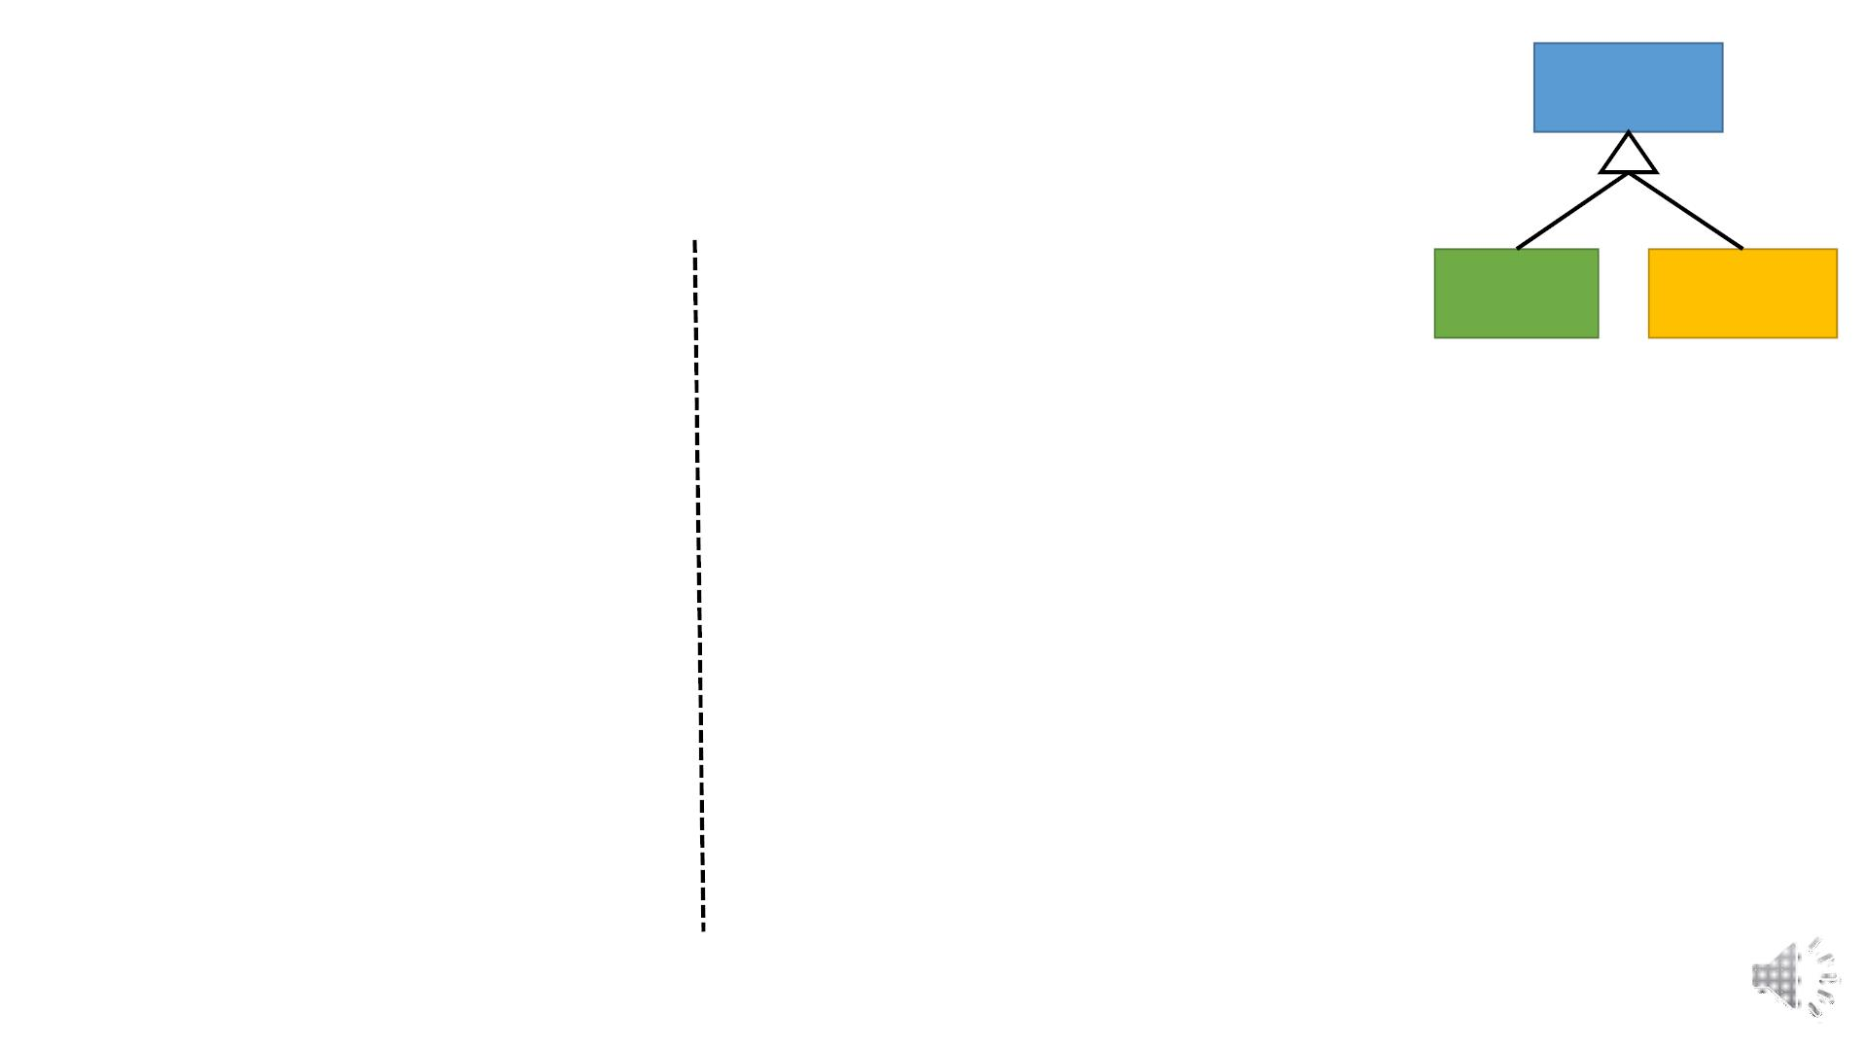
Account
Inheritance (is-a) Polymorphism Example
class Account{
class Current: public Account{
int accountNo;
float serviceCharges;
float minBalance;
Saving
Current
float amount;
public:
public:
virtual void print() override{
Account::print();
//override Debit and Credit
functions according to derived
classes.
cout<<serviceCharges;
}
virtual ~Current(){}
virtual void debit(float);
virtual void credit (float);
virtual void print(){
cout<< accountNo ;
cout<< amount <<endl;
}
//Use inherited Debit and Credit
};
class Saving: public Account{
float interestRate;
public:
virtual void print() override{
Account::print();
virtual ~Account(){}
cout<<interestRate;
}
};
virtual ~Saving(){}
//override Debit and Credit
virtual void debit(float) override;
virtual void credit (float) override;
};

Slide 22
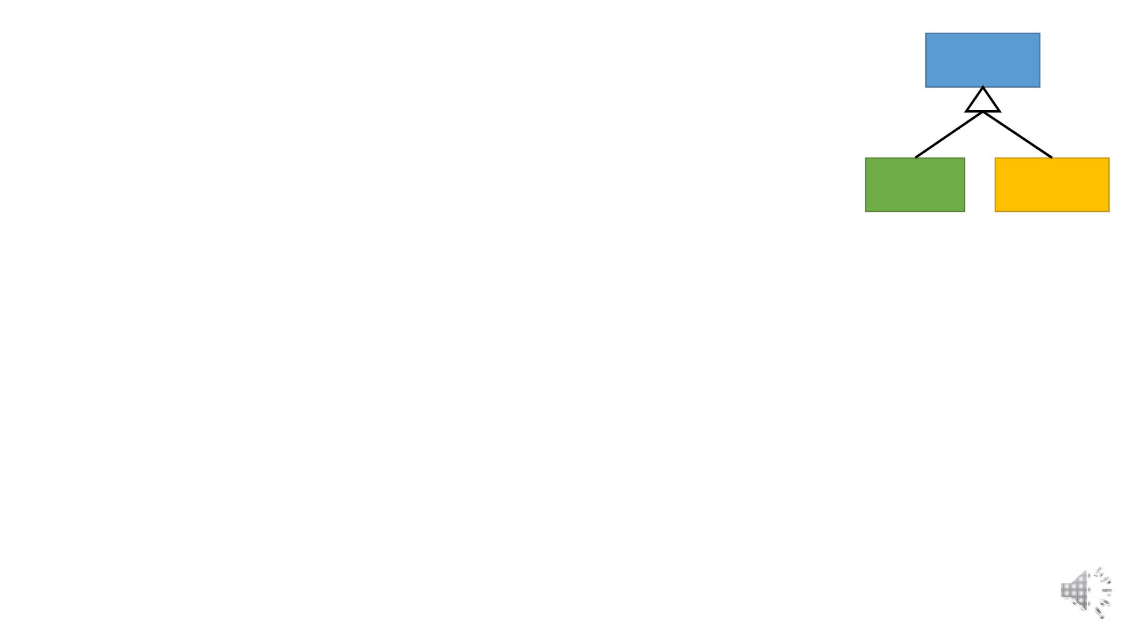
Account
Inheritance (is-a) Polymorphism Example
• Call the function according to the type of object not pointer.
• Debit, credit and print function are different for different accounts.
void main(){
Saving
Current
Account * a1 = new Saving; //Base pointer to derived object
a1->print(); //Saving’s print called.
a1->debit(300); //Saving’s Debit called.
a1->credit(900); //Saving’s credit called.
Account * a2 = new Current; //Base pointer to derived object
a2->print(); //Current’s print called.
a2->debit(500); //Current’s Debit called.
a2->credit(30085); // Current’s credit called.
delete a1; //Saving destructor called, then Account
delete a2; //Current destructor called, then Account
}

Slide 23
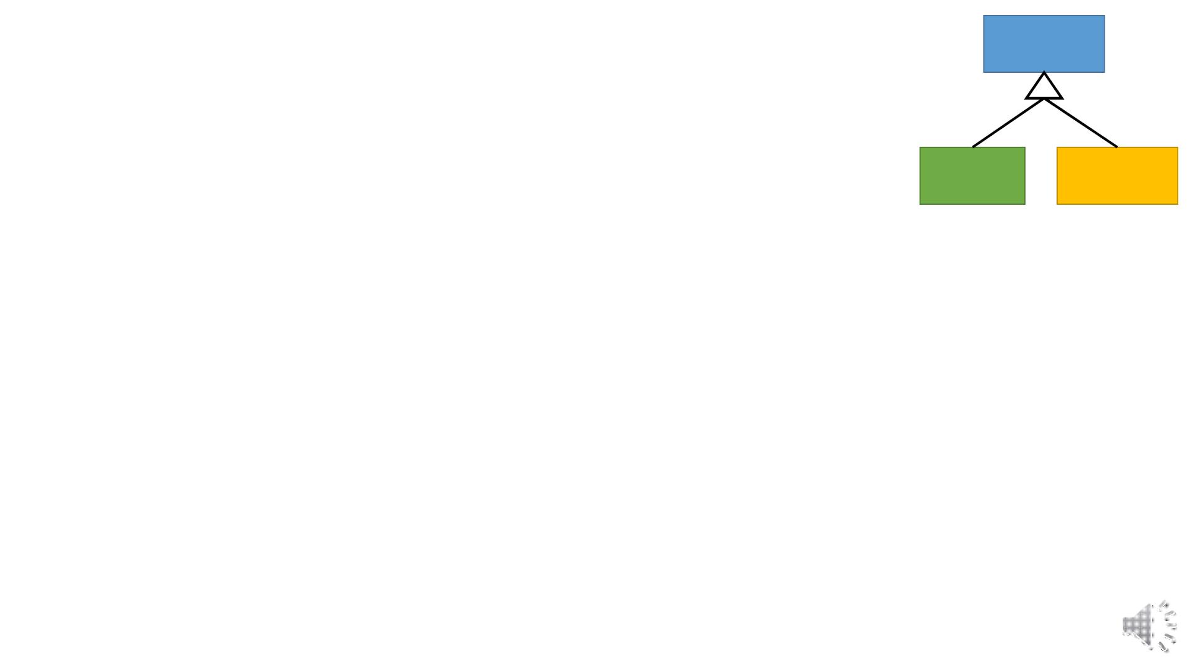
Account
Inheritance (is-a) Polymorphism Example
• Maintain a single array of Account instead of two separate arrays.
void main(){
Saving
Current
//Array of base pointers
Account ** alist = new Account*[10];
alist[0] = new Saving;
alist[1] = new Current;
alist[2] = new Account;
….
//Print data of all accounts polymorphic behavior
for(int i=0; i<10 ;i++)
alist[i]->print();
//credit and debit polymorphic behavior
alist[0]->credit(50);
alist[2]->debit(333);
}

Slide 24
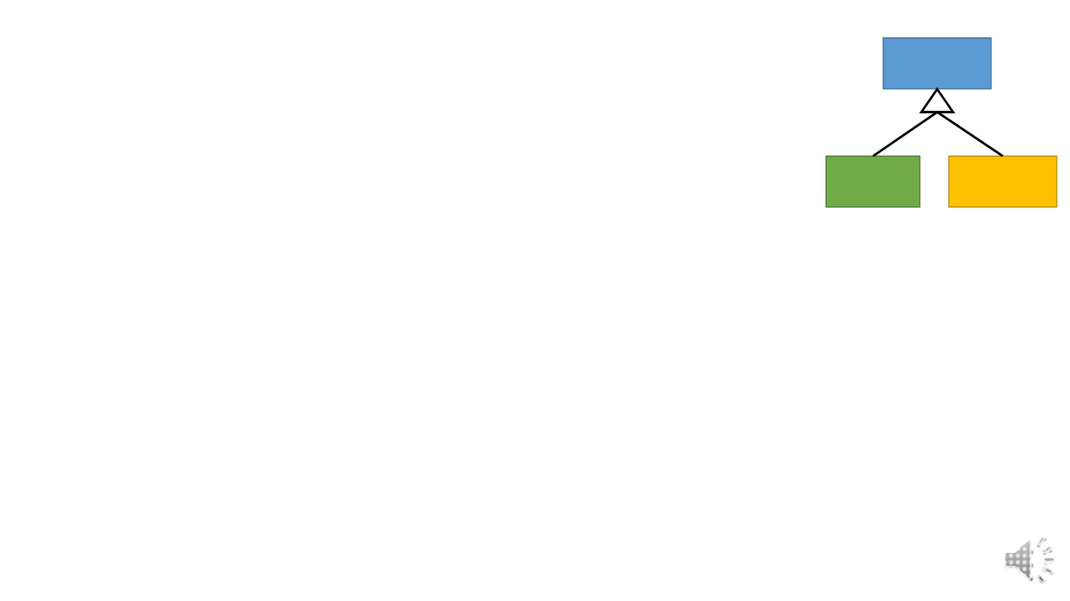
Account
Inheritance (is-a) Polymorphism Example
• Maintain a single array of Account instead of two separate arrays.
//Destructors show polymorphic behavior
Saving
Current
//Destructors are called according to object type
//Destroy all accounts
for(int i=0; i<10 ;i++)
delete alist[i];
//Deallocate array of pointers
delete [] alist;

Slide 25
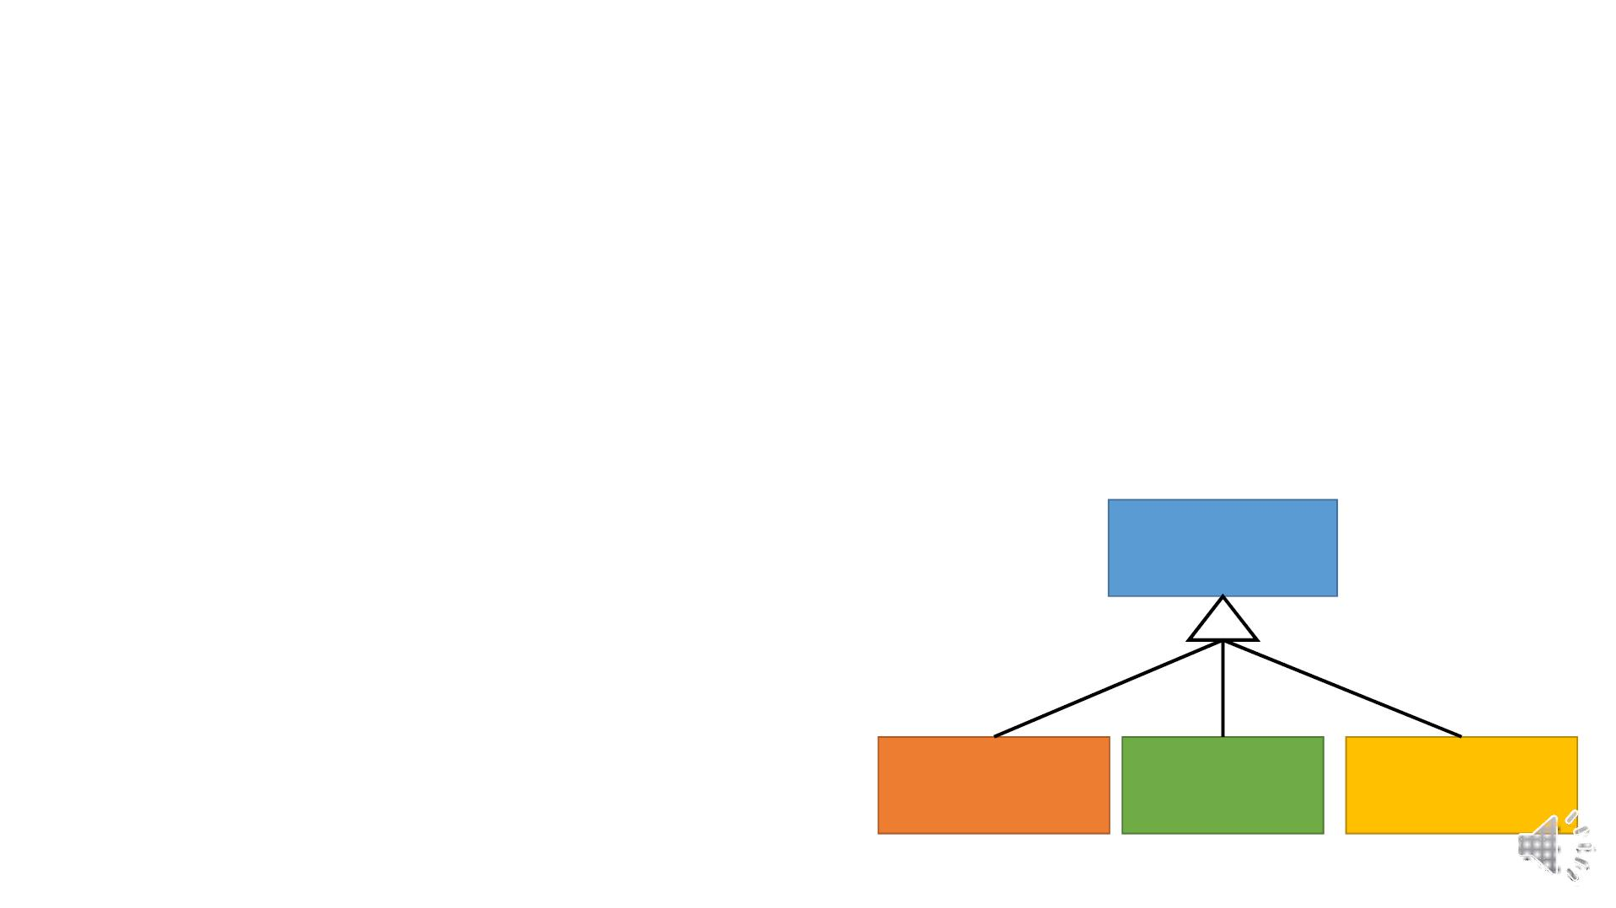
Inheritance (is-a) Polymorphism Example
• Create a payroll program for 3 types of employees, paid monthly
• Salaried (fixed salary, no matter the hours)
• Hourly (overtime [>40 hours] pays time and a half)
• Commission (paid percentage of sales)
1. Each employee’s pay will be calculated in different way.
2. Override calculatePay function in all employees accordingly.
3. Convert the binding to Runtime in employee class.
Employee
virtual float calculatePay();
Commission Salaried
Hourly
Employee Employee Employee

